Slide 1

Clean Presentation
Fresh and uplifting

Slide 2

agenda
Introduction
Topic One
Topic Two
Topic Three
Conclusion

Slide 3
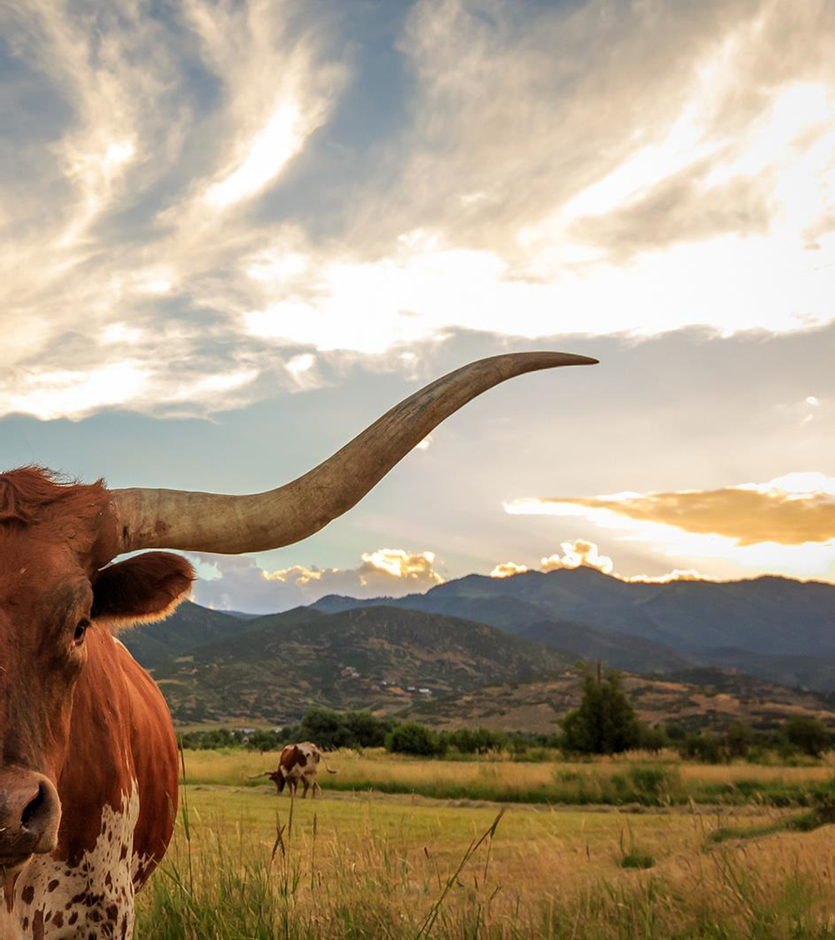
Topic One
Subtopics and info

Slide 4

Topic One
Insert a paragraph to describe your topics to let the audience know what you are speaking about.
Add more as needed so they know what this is about and can clearly understand it.
Describe nuanced details and give examples to make them easier to explain.
Tell a joke and a personal story to get the audience warmed up.

Slide 5

Topic One
Amazing details

Slide 6
Topical details
Q3
Some things
Q4
Exciting milestone
Q1
And stuff
Q2
Improvements
Here is a bullet point about some things
And here is one on some stuff
Discuss the milestones and improvements

Slide 7

Educational decisions
How did we get here?
Where are we going
Collaborate with influencers and thought leaders to amplify our brand message

Slide 8

financial overview
Our monies speak for themselves.
Consistent profit driven through solid revenues, decreased costs, and attention to detail.
Through deliberate prudent financial decisions we have established ourselves as a dominant player in the industry.

Slide 9
charts
Market expansion
Product innovation
Customer retention
Operational efficiency
Quarter | Revenue growth (%) | Market share increase (%) | Customer acquisition
Q1 | 12 | 2 | 500
Q2 | 15 | 3 | 600
Q3 | 18 | 4 | 700
Q4 | 20 | 5 | 800

Slide 10
More numbers
Metric | Current value | Previous quarter | Change (%)
Revenue | $2,500,000 | $2,200,000 | +14%
Operating expenses | $1,200,000 | $1,400,000 | -14%
Net profit | $1,000,000 | $800,000 | +25%
Operating margin | 40% | 36% | +4%
Cash reserves | $5,000,000 | $4,500,000 | +11%

Slide 11

Innovative solutions

Slide 12

initiatives
Essential upgrades to integrative services.
Important regulatory oversight and stewardship.
Charitable contributions.
Market analysis
Improved communication
Charitable sevices

Slide 13
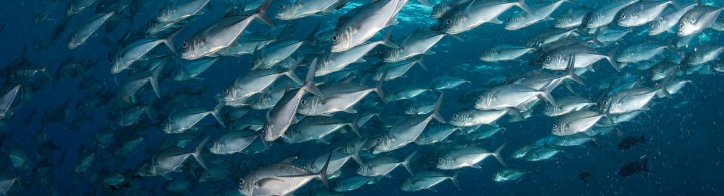
Our info
Speaker Name
123-456-789
speaker@website.com
www.website.com

